Slide 1
ANALYTICS
Win Probability, Shot Difficulty & Video
Prepared by Renee Sonnenberg
Performance Analyst
Presented by ________

Slide 2
TOPICS
Win Probability
Shot Difficulty
Video

Slide 3
What percentage of games go full length?
Notes:
If you take 100 games, how many of those games would have the last rock thrown in the last end?

Slide 4
45% of games go the full length
Notes:
Less than half the games go full length.
This is important because it means that one team has a large enough win probability before the game is even over. How do we make sure it is our team?

Slide 5
WIN PROBABILITY

Slide 6
Every end and score differential has a win probability linked to it.
0-100%
W/M
Hammer at start – 60%/62%
Tied coming home with – 72%/79%
Tied with after 4 ends – 61%/63%
Up 1 coming home without – 57%
Notes:
Women’s probability listed first (W), Men’s probability listed second (M)

Slide 7
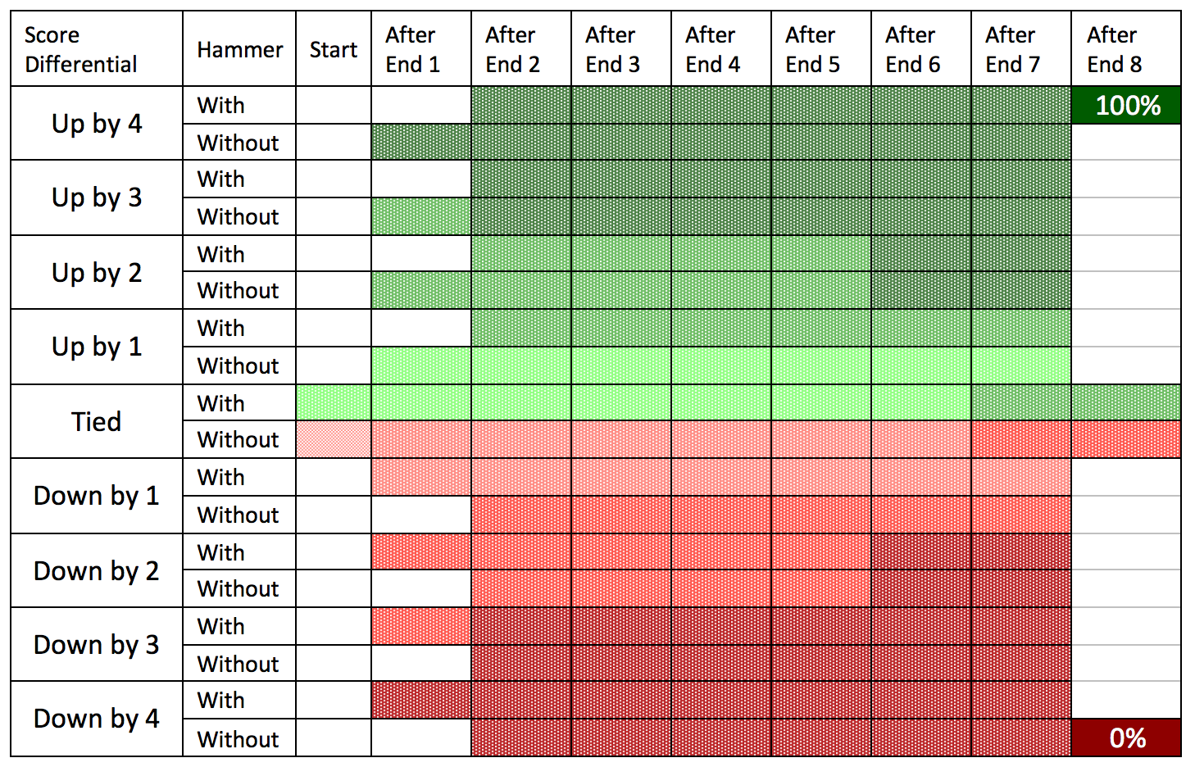
ADVANTAGE
DISADVANTAGE
Notes:
There is no game in curling where the win probability is 50/50. Green indicates that a team has a greater than 55% chance of winning, red indicates that a team has a less than 45% chance of winning.
Score differential is on the left-hand column, End of play along the top.
We use the term “in advantage” when they are green and have a greater than 55% chance of winning.
Where is the tipping point between red and green?
ANSWER: Tied with or up in score (with or without hammer)
Disadvantage: tied without or down is score (with or without hammer)

Slide 8
85-100%
70-84%
50-69%%
31-49%
16-30%
0-15%
Notes:
Light green – 55-70% win probability
Middle green – 70-84% win probability
Dark green – 85-100% win probability
Light red – 30-45% win probability
Medium red – 16-30% win probability
Dark red – 0-15% win probability
Ask coaches to identify color for each of the following:
Tied with after 4 ends (light green)
Down 4 with after 1 end (dark red)
Down 2 with after 4 ends (middle red)
Up 2 without after 3 ends (middle green)

Slide 9
SCOREBOARD
Notes:
This is the linescore from the 2022 Beijing Olympic Women’s Gold Medal.
What stands out?
4 in 6
2 in first
Steal of 1 in 5th
Now here is the picture of the win probability.
Notice the impact of the 2 in end 1, the steal in end 5 and the 4 in end 7.

Slide 10
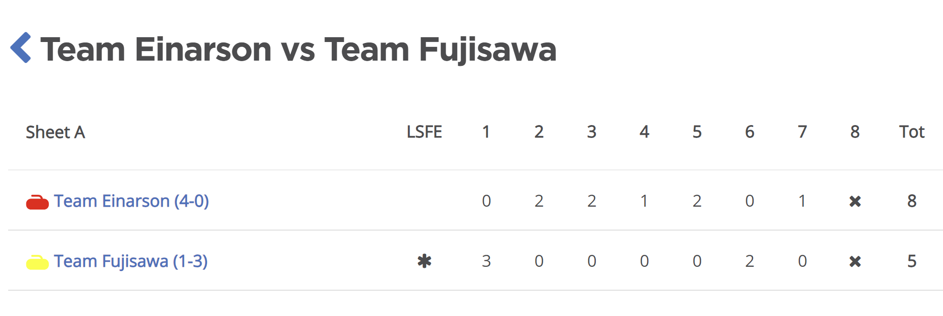
Let’s Practice
Notes:
EACH COACH NEEDS A COPY OF THE WP TRACKER.
Each click reveals a new end score. Participants should fill in their win probability chart as you go.

Slide 11
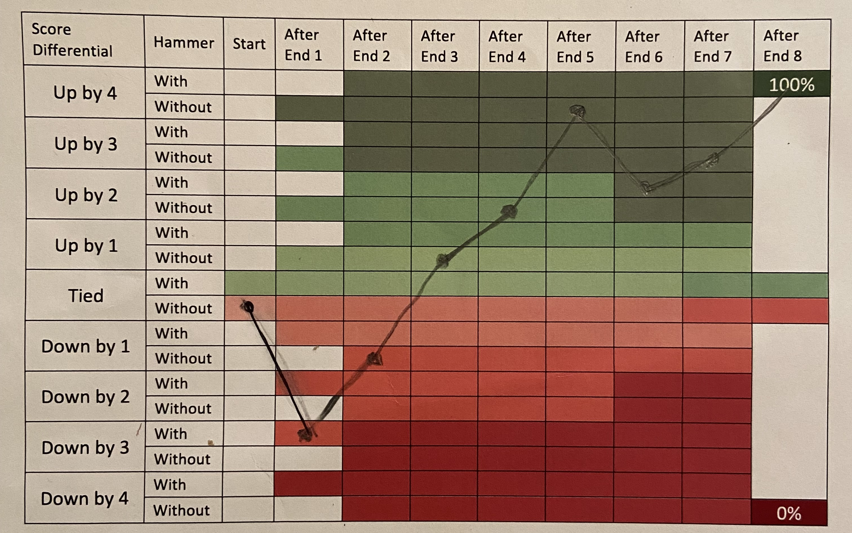

Slide 12
Scoreboard
ADVANTAGE
up in score
tied with hammer
tied without hammer
down in score
DISADVANTAGE
To win games, you need to hold an advantage at the end of the game.
Notes:
As a reminder…

Slide 13
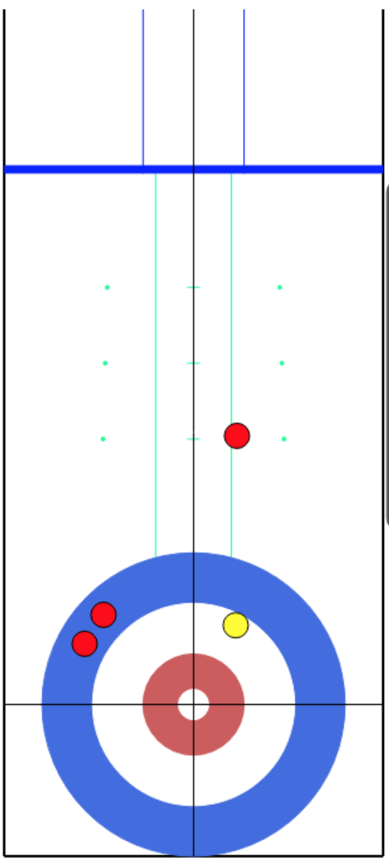
You are red: Draw for 1 or
runback for 2/3?
5th end
up 1 with
last rock (red)
5th end
tied with
last rock (red)
6th end
down 3 with
last rock (red)
Notes:
You are red, last rock coming. Assume decent ice conditions.
For each scenario, what can happen on the scoreboard to be in advantage?
5th end up 1 with
Take 1 – up 2 without next end – in advantage
Give up steal of 1 – tied with next end – in advantage
Take 2 or 3 – increase advantage
5th end tied with
Take 1 – up 1 without next end – in advantage
Give up a steal of 1 – down 1 with next end – IN DISADVANTAGE
Take 2 or 3 – increase advantage
6th end down 3 with
All results are disadvantage but taking 2/3 is the best option to get closer to advantage

Slide 14
Know Where You Are
Advantage Maintain/Increase
Disadvantage Improve/Flip
Notes:
When in Advantage, your primary objective is to maintain that advantage and then to increase it.
When in Disadvantage, particularly early in games, your primary objective is to get closer to green then flip (red to green).

Slide 15
In General…
Blank or Score 1 – Maintains win probability
Multiple for – Increases win probability
Steal for – Increases win probability
Steal against – Decreases win probability
Multiple against – Decreases win probability
Notes:
These points work for all win probability scenarios.

Slide 16
SHOT DIFFICULTY

Slide 17
Offence
(Pursue)
Jockeying
(Probe)
Defense
(Protect)
Notes:
When we have a lower win probability, we are down in score and we need rocks in place and chaos, this means our shots are more difficult – draws, freezes, taps, guards… HARDER shots with more precision required.
When we have a higher win probability we are up in score and therefore need to limit scoring and rocks in play – hits, peels,… EASIER shots with less precision required

Slide 18
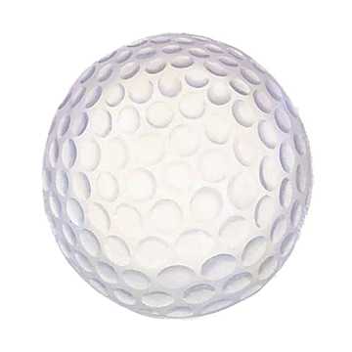
Shot Difficulty
Hit/Draw
A
B
C
Come around, hit and roll, through port, raise, avoid backing, freeze, split/tick, double etc…
A = single word
B = contains one descriptor
C = contains 2 or more descriptors
Notes:
Shots that can be described with a single word – hit/draw are easier, precision required is the size of a beach ball.
Medium difficulty shots usually contain one descriptor – come around draw, double takeout, hit and roll and precision is the size of a soccer ball.
Higher difficulty shots contain multiple descriptors – come around draw through port, run back double, come around angle freeze to bite 8’ and the precision required is the size of a golf ball.
Teams should live as much as they can in the level A&B shots. The ability to execute is higher. Sometimes C-shots cannot be avoided but be aware that they are hard!
Better execution (easier shots) leads to a higher shooting percentage.

Slide 19
CONTEXT
Make – Partial – Miss
Type of error
Tolerance
Difficulty
Weight Control
Notes:
When tracking shots here are some things to consider.
Make/Partial/Miss
Error type – light, heavy, undercurl, overcurl
Tolerance – in/out of tolerance
Difficulty – A/B/C
Weight Control – throwing the requested weight

Slide 20
Notes:
Example 1 – Track Make/Partial/Miss
Forward slash – make, green
Flat line – partial, yellow
Backward slash – miss – pink
Example 2 – Weight Control
Desired weight written on top (zone # for draw, letter for hit – C=Control, P=Normal, H = hack….)
Actual weight thrown written underneath then color coded.
Green – good weight, Yellow – Heavy, Pink – Light
Check mark – missed time but weight was good
Example 3 – Error Type
D for draw, H for hit
Green check mark = good
Weight issue – pink
Line issue – yellow
If there are 2 issues then pick the most significant/impactful one.

Slide 21
Analytics Tips
Not all needs to be shared with entire team.
Be purposeful in your training.
Catch your athletes doing things well.
Notes:
During an event, less is more, pick a few talking points and save more for training.
Use what you see in games to inform training. Heavy on a lot of draws – create a drill for that. Hitting and rolling out because of too much weight – create a drill for that.
Be sure to include times when things are going well.
2 makes in a row – great work
No misses in an end – awesome
Control weight nailed – hooray…

Slide 22
VIDEO

Slide 23
VIDEO
Notes:
Perception is not always reality.
Each of the 4 athletes views the same shot from a different vantage point – broom holder, thrower, brushers on opposite sides.
Video helps get the athletes right back into the same moment.

Slide 24
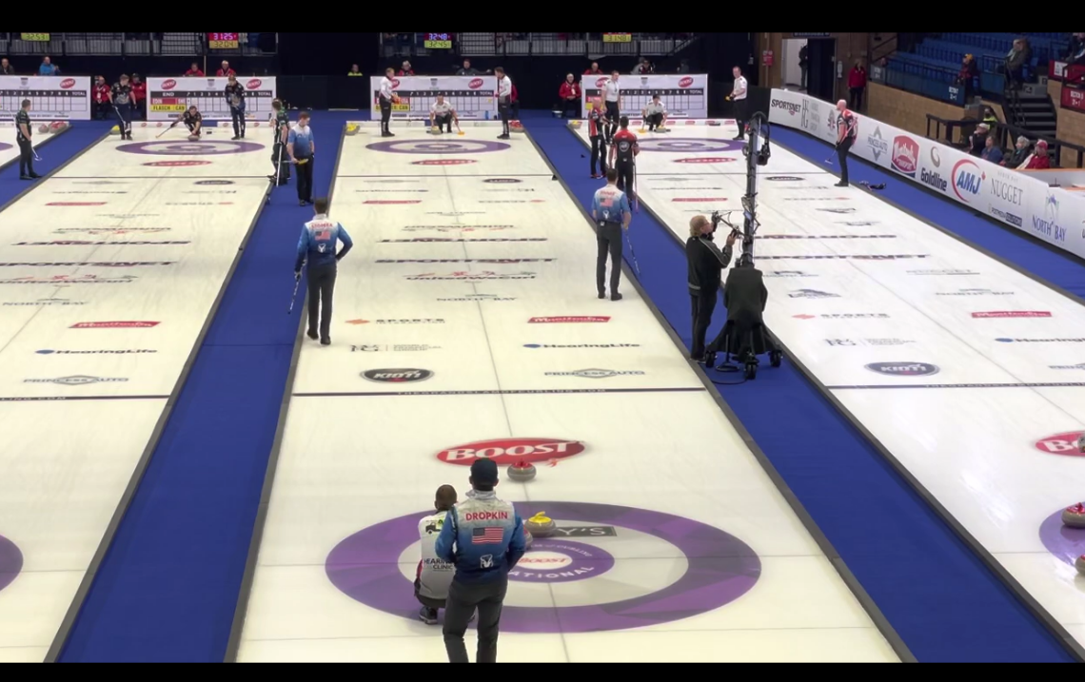
Notes:
It is helpful to see the whole shot slide, management, break point….
If it is difficult to see the far end here, so if you use an iPad zoom in to see the rock positions.

Slide 25
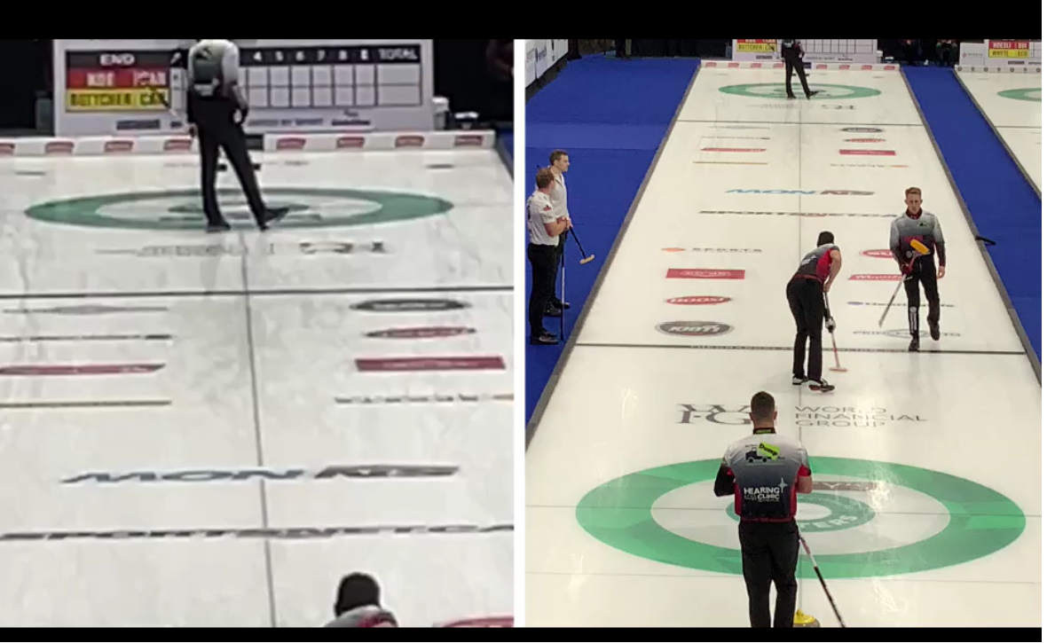
Notes:
Using an app like Switcher Studio, you can get a better view of the away end and still see the whole shot.

Slide 26
VIDEO TIPS
Time stamps
Whole sheet
Include hack
Notes:
Video is also helpful to record time stamps when you want to review a scenario in debrief.
Seeing the whole sheet allows you to view management as well as tactics.
Including the near hack can sometimes help show a technical aspect of the deliveries.

Slide 27
WINNING
LEARNING
Notes:
It is important to remember there is never winning and losing.
It is always winning and learning. These tools will help both!

Slide 28
QUESTIONS?

