Slide 1
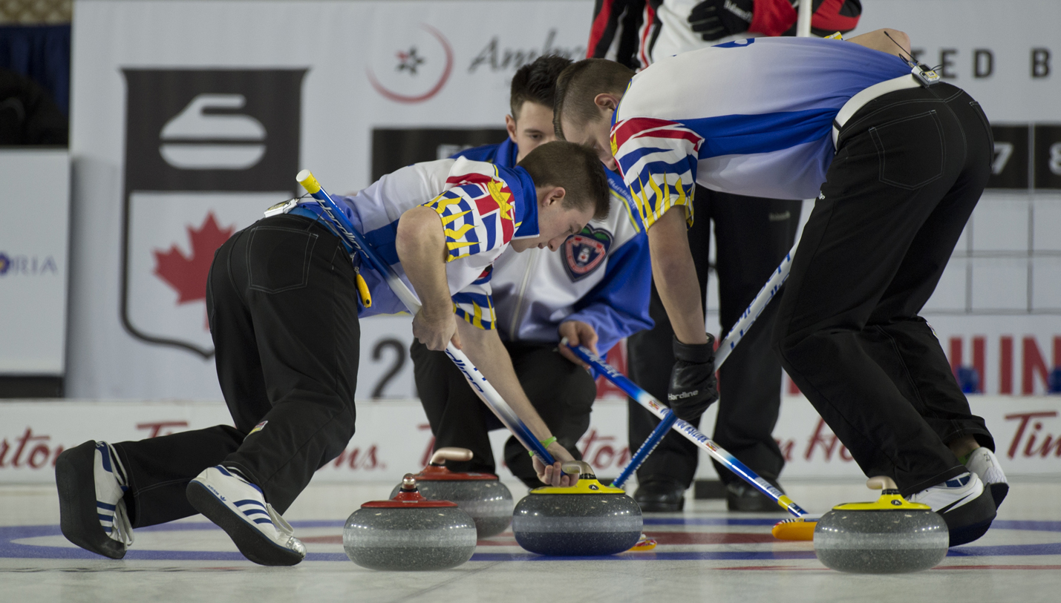
Brushing Update Curling Canada MA HPD Summit
John Newhook, Dalhousie University
Glenn Paulley, Ontario Curling Council
Version 1
August 2023

Slide 2
Agenda
What we know
What we think we know
What we would really like to know
Future research

Slide 3
What we know
The physics of curling is amazingly complicated, and we’ve been studying it for almost 100 years. Yet we still don’t know …. a lot!

Slide 4
Brushing parameters
In addition to the selection of the specific brush(es) being used, there are four main parameters to brushing that can be controlled by a team:
The force profile(s) of the brusher(s)
The orientation of the brush stroke relative to the path of the stone (sometimes termed the “angle of attack”)
The number of brushers (one versus two)
The duration of the brushing, and when it is performed
For example, before or after the break point

Slide 5
Brushing parameters
What cannot be controlled by a team that may impact brushing:
Ice conditions
Pebble height, density, shape, quality
Ice temperature and its consistency
Arena conditions
Air temperature, dew point, relative humidity
Presence of frost
Stone characteristics
Stone weight, characteristics of striking bands
Roughness and consistency of running bands

Slide 6
What does brushing do?
Clears debris from in front of the stone
Polishes the pebble (with WCF-approved fabric)
Helps to remove frost
Warms the ice surface
Brushing has both a thermal and a mechanical effect
All brush heads are abrasive to an extent
However, WCF-approved Oxford 55 420 Denier fabric does not “scratch” pebble in normal usage

Slide 7
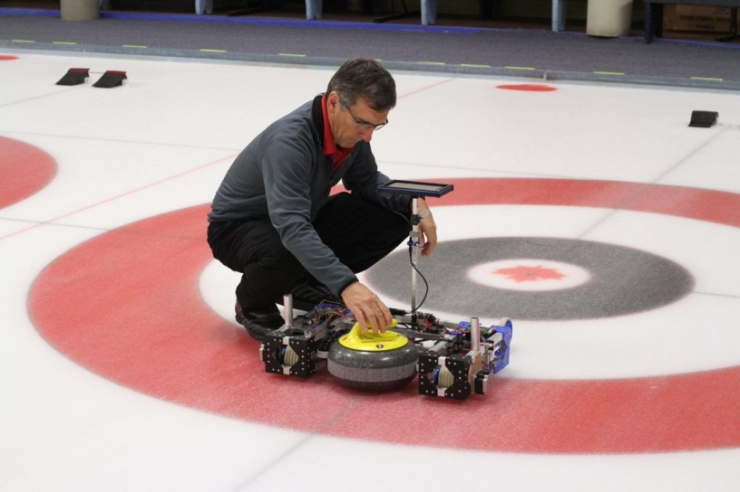
What does brushing do?
Brushing heats the ice surface:
Warming is asymmetric throughout a brush stroke, hence warming depends on the angle of attack
Second brusher does contribute to ice warming – perhaps as high as 20%
Heat lowers frictional forces on the stone from approximately 1.4-1.45 N to 1.1 N or lower, depending on the force applied and the area of ice coverage
Randy Park, P.Eng, M.Eng

Slide 8
There are lots of unknowns
Relationship between brushing and its effect on a curling stone is not well-understood
Debate in scientific community over what makes a stone `curl’
Some techniques and angles of attack appear to yield better results than others
Stone and ice characteristics play a very significant role in brushing effectiveness

Slide 9
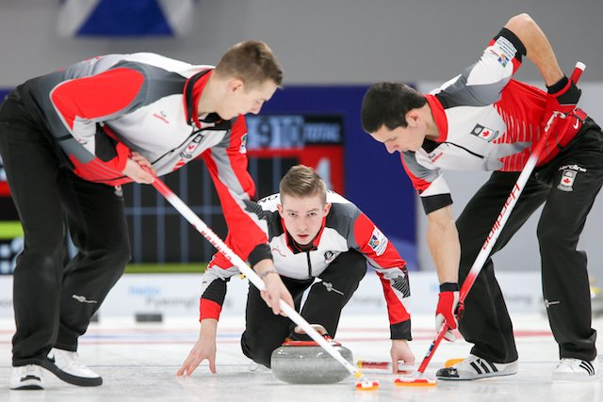
Current coaching tools in Canada
Manuals on technique – best practice from experience
General guidance
Not individualized
‘source of evidence’ not apparent
Most under-coached aspect of the sport
A few studies but very little published data
Small sample sizes
No detailed description of methodology or results
Difficult to apply these results to athletes of varying characteristics and abilities

Slide 10
Mechanics of Brushing

Slide 11
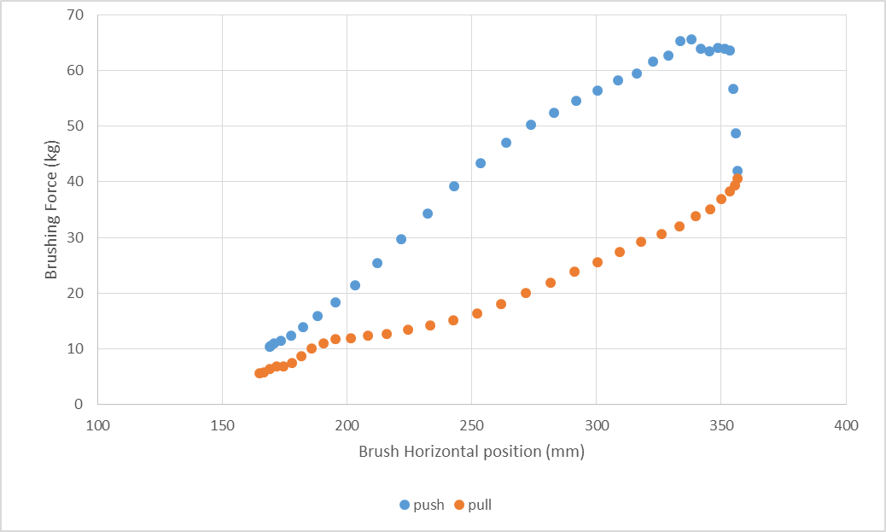
Anatomy of a single brushing stroke
Brusher’s Feet –
This Side

Slide 12
Vertical force versus time
Maximum force is attained during initial phase of the push component

Slide 13
Understanding asymmetric force
The asymmetry in vertical force through a stroke yields differing amounts of thermal energy
Asymmetric force applied in front of a stone can impose a directional effect to a stone’s trajectory
Similarly, reducing asymmetry, by either increasing sustained forces or using two brushers, can help to minimize directional effects, yet still increase carry

Slide 14
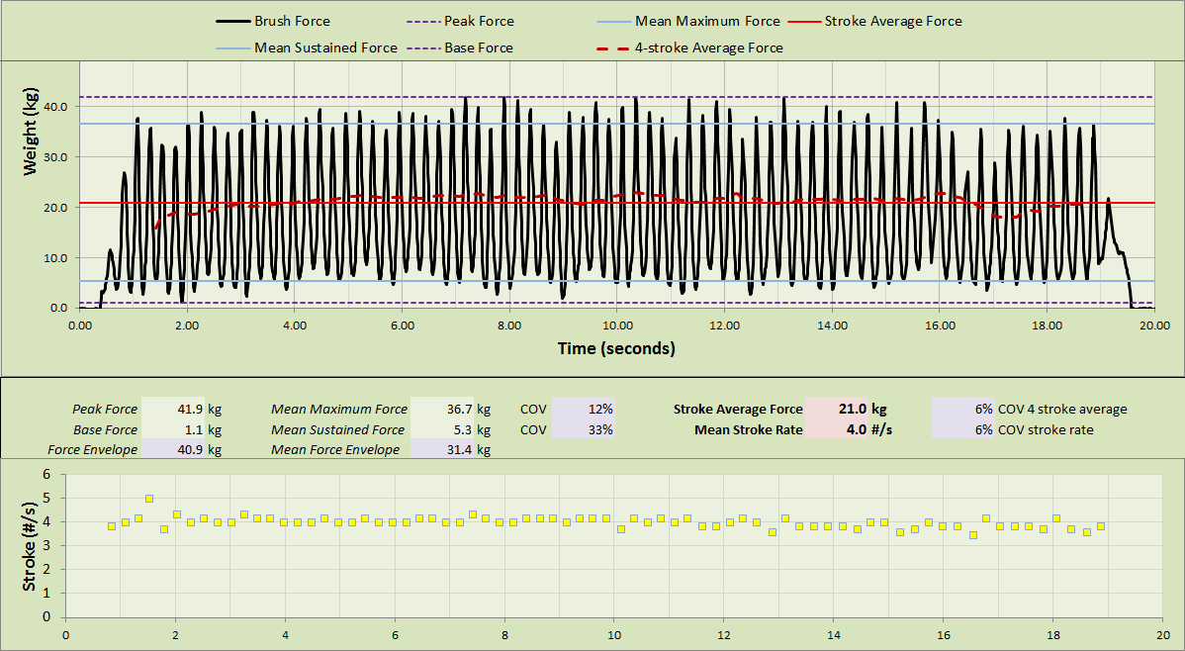
High-performance female athlete

Slide 15
High-performance female athlete
Notes:
Stroke rate is 4.0 strokes/second
This athlete weighs 47 kg (103.4 lbs)
Ratio of mean sustained force to body weight is 11.2%
Ratio of mean maximum force to body weight is 78%
Ratio of mean brushing force to body weight is 45%
Immediate question: just how good is 45%?

Slide 16
Normalizing force by body weight
It is difficult to compare different players due to different physical characteristics
The following graphs make a compelling argument for computing an athlete’s brushing efficiency by normalizing their force by body weight
There is surprisingly little difference in efficiency between top male and female players
Can use a normalized force metric as a measurement of an athlete’s improvement – to be the best they can be, given their physical size

Slide 17
Male vs female performance

Slide 18
Normalized force by body weight

Slide 19
Normative data
In our combined brushing study of approximately 700 athletes and thousands of bouts across various LTCD stages, we can state that:
Average stroke rate is 4.2 strokes/second
Both genders, all adult competitive levels
Little variance with few outliers – ideally one would like to maintain their force levels and yet brush faster to achieve greater ice coverage
A normalized mean force of 45-50% is excellent (both men and women)
Normalized mean force greater than 50% is superb
Many competitive players, even Tour players, do not come close to this
Some athletes are in the 20% range, many are in the 30% range

Slide 20
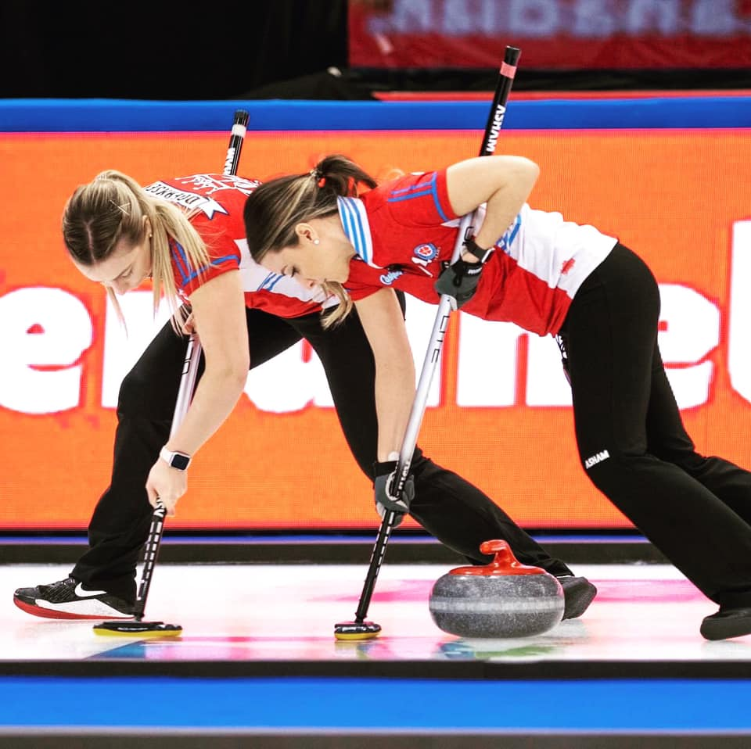
Normative data
Athletes to watch:
Open stance: Kaitlyn Lawes, Jenna Loder, Connor Njegovan, Lauren Lenentine, Sarah Wilkes, Skylar Ackerman
Closed stance: Kaitlyn Lawes, Emily Zacharias, Brad Jacobs, Skylar Ackerman, Sarah Wilkes

Slide 21
Training targets for brushing
LTCD Stage | Gender | Maximum Force (BM Ratio) | Sustained Force (BM Ratio) | Mean Brushing Force (BM Ratio) | Mean Stroke Rate
Learn to Train | Both | 0.50-0.60 | 0.02-0.05 | 0.25-0.30 | 3.0-4.0
Train to Train | Both | 0.60-0.70 | 0.05-0.10 | 0.30-0.35 | 3.5+
Learn/Train to Compete | Female | 0.70-0.80 | 0.10-0.15 | 0.35-0.45 | 3.5-4.5
Learn/Train to Excel | Female | 0.75-0.85 | 0.15-0.20 | 0.45-0.55 | 3.5-4.5
Learn/Train to Compete | Male | 0.70-0.75 | 0.10-0.18 | 0.40-0.45 | 4.0-5.0
Learn/Train to Excel | Male | 0.75-0.95 | 0.18-0.25 | 0.45-0.55 | 4.0-5.0

Slide 22
Instrumented brushes
Game changer for coaching, however:
New “SmartBroom” from Canadian Curling Tools is remarkably inaccurate
Poor quality control
Often grossly overstates force
No published specification of accuracy
Device error usually exceeds an athlete’s typical improvement when coached

Slide 23
CurlSmart prototype brush
Developed by John Newhook and his engineering team at Dalhousie University
Captures vertical force in Newtons
Force in kg, stroke rate computed by custom Matlab software
Wireless data transmission to PC
Very accurate – within 2%
Controlled entirely from the PC
Self-zeroing

Slide 24
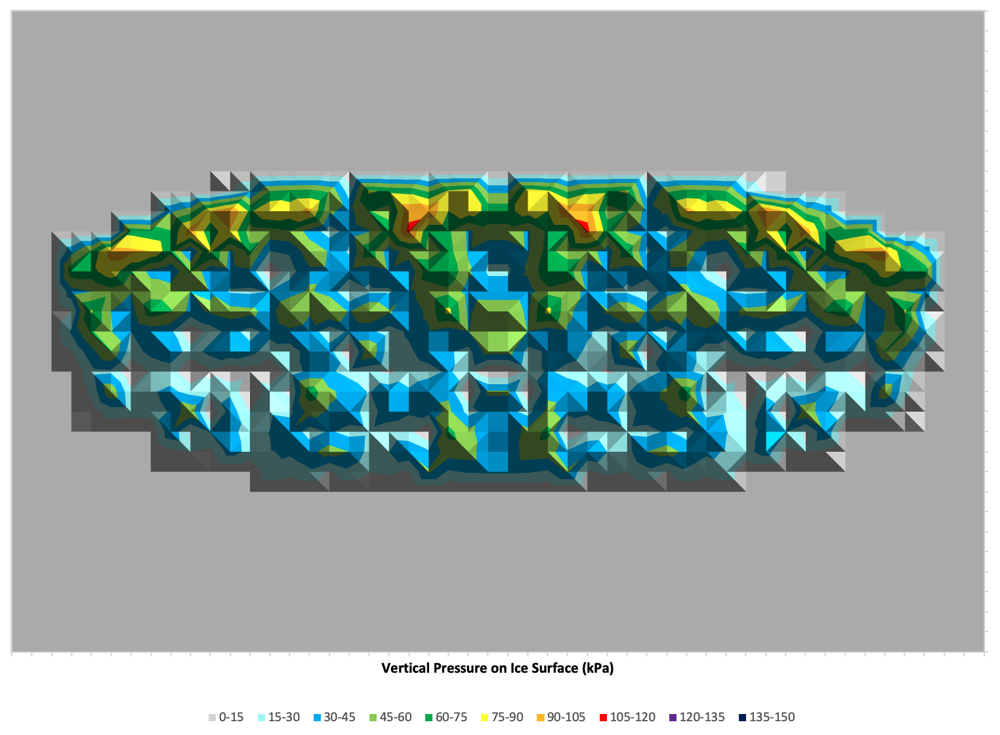
Brush pad pressure distributions
Assessment of brush pad wear and dirt patterns led to a detailed study to measure pressure distributions across different brush heads
Significant differences exist across brands and models as companies strive for lightweight equipment designs
Preliminary results presented at NACOB 2022, research is continuing
Impact of different brush head designs on a stone remains unclear

Slide 25
What we think we know

Slide 26
Carry distance
Some limited trials indicate (unsurprisingly) a positive correlation between mean brushing force and carry distance
Maximal carry distance varies with ice and stone conditions but experiments show the range is between 4 and 15 feet with a single athlete
Two brushers are better than one – in limited trials
Ice conditions play a very significant role
On keen ice a solitary top player can maximize carry distance
However most female players will struggle to generate the necessary force
Brushing strategies for junior women should not mimic men’s teams

Slide 27
Directional effects
It is clear that directional brushing can be used to prevent or accentuate curl
Ice conditions play a significant role in what can be achieved
It is possible that there is a force threshold that must be met to achieve any particular effect
Experiments show that the impact of directional brushing can be as much as 6-7 inches at hack weight

Slide 28
Directional effects
Limited studies indicate a second brusher improves hold at board weight or less, but confounds any attempt to accentuate curl
Directional brushing does not work all the time
Hint: it’s the ice
Ice conditions play a very significant role in the magnitude of the effect
We believe that running band characteristics also play a role but this has not been studied to any extent

Slide 29
What we would like to know

Slide 30
Physics of curling
Can we quantify the characteristics of “good ice” for brushing?
What is the vertical force threshold that, if exceeded, results in negligible additional carry?
What is the impact of the mechanical effect of brushing, rather than the thermal effect, on pebble abrasion and directional effects? How can we quantify this mechanical effect?
What are the characteristics of ice (or the arena) that fail to support directional brushing effects?
Why does a second brusher seem to confound any attempt to accentuate curl?

Slide 31
Physics of curling
What parameters make up the interaction forces that determines the trajectory of a curling stone?
Does stone temperature impact brushing effectiveness?
Does a curling stone itself produce a thermal effect?
How does a stone’s rotation influence brushing effectiveness?
How does the roughness of a running band influence brushing effectiveness?
Why does brushed ice continue to support greater carry for subsequent shots performed without brushing?

Slide 32
Brushing mechanics
What are the best techniques (angle of attack, brush head placement, brush pad orientation) to use when trying to prevent or accentuate curl?
Does knifing do anything? If so, what?
Does the variation in brush pad pressure distribution across differing brushes have a measurable impact on a stone? If so, how do they differ?
What is a good metric to describe brushing proficiency, and what additional information do we need, in addition to vertical force and stroke rate, to compute it?

Slide 33
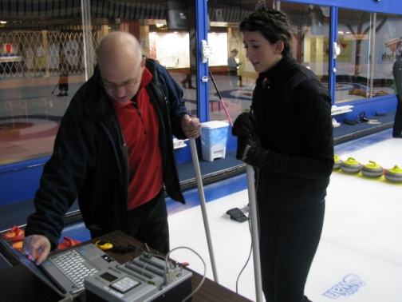
Future research

Slide 34
Our objectives
☑️ Provide athletes and coaches with training level data
Allow them to see impact of changes in technique
Allow them to track development and performance over a period of time
Set target performance levels for various groups
Provide coaches and researchers with tools to study brushing technique and increase our understanding
Better understand the physics behind curling and how brushing interacts with a stone’s interaction forces to produce the desired result
Develop drills and additional apparatus to assist with skill development

Slide 35
Thank you!
glennpaulley@gmail.com Twitter: @gpaulley
John.Newhook@Dal.ca Twitter: @JPNewhook

