Slide 1
Delivery Principles National Training and Development Centre

Slide 2
A Functional Motion
The function of the curling delivery is to produce the intended line, weight, and rotation on a consistent basis, and in the process to make as many shots as possible.
National Training and Development Centre

Slide 3
The Anatomy of a Curling Shot
Line
Weight
Rotation
National Training and Development Centre

Slide 4
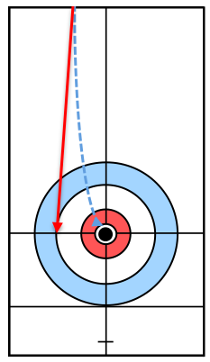
Line = Direction
Line is the rock’s initial direction, which starts out on a straight path and eventually begins to curl as it travels down the ice.
National Training and Development Centre

Slide 5
The Old Image of Line
The old image of a Single Line running from the middle of the rock to the target broom can be limiting for advanced curlers.
This image only allows for a perfectly centred slide, and only accommodates a pure (i.e., straight-through) release.
National Training and Development Centre

Slide 6
A New Image of Line
A new image of Two Lines (i.e., a Lane) about a broom head wider than the rock, addresses both of these limitations.
This image allows for a slide that is slightly off-centre, and gives curlers the option of a pure, mini-set, or set release.
National Training and Development Centre

Slide 7
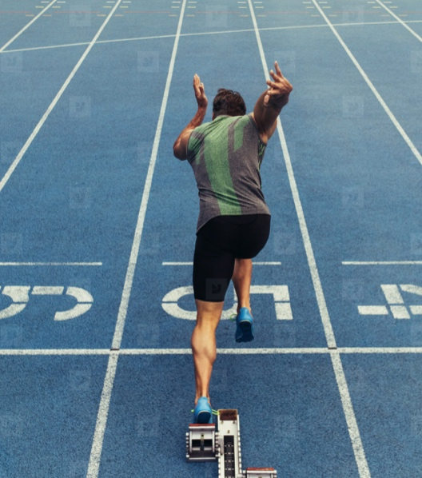
Stay in Your Lane
We like to use the analogy of a sprinter running in their lane. This gives curlers a little more freedom to nail their line.
National Training and Development Centre

Slide 8
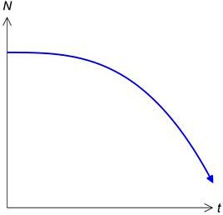
Weight = Speed
Weight is the rock’s initial speed, which will decelerate steadily and predictably as it travels down the ice.
National Training and Development Centre

Slide 9
Deceleration Realities
Regardless of the shot being played, both rock and body will begin to decelerate immediately after as the Slide begins.
While its shape will depend on the specific weight of the shot, this deceleration can always be seen as a downward curve.
National Training and Development Centre

Slide 10
Managing Deceleration
Knowing where the rock is on its deceleration curve can make it easier to find the right weight for the shot.
Once this right weight is found, a controlled arm extension is the best way to preserve that weight until the rock is released.
National Training and Development Centre

Slide 11
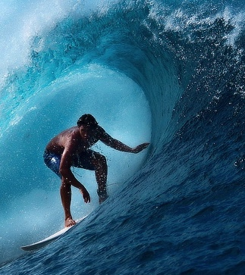
Ride the Curve
We like to use the analogy of a surfer riding a wave. This can help curlers to envision the rock’s deceleration curve.
National Training and Development Centre

Slide 12
Rotation = Spin
Rotation is the rock’s initial spin, which will also decelerate steadily and predictably as it travels down the ice.
National Training and Development Centre

Slide 13
Optimal Rotation
Advanced curlers are best to employ 4.5 to 5.0+ rotations in order to manage championship playing conditions.
This has a positive impact on line by delaying the break point, and on weight by creating additional carry.
National Training and Development Centre

Slide 14
Key Contributors
It’s important to start with appropriate handle positions, along with sufficient grip pressure.
The other key contributor is a consistent release tempo (i.e., the cadence of turn application).
National Training and Development Centre

Slide 15
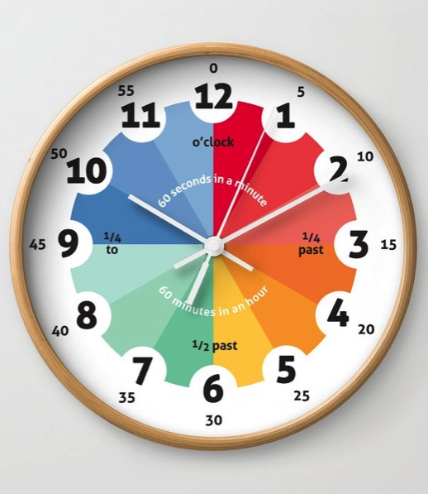
Set the Clock
We like to use the analogy of an ‘old-school’ analog clock. This helps curlers to be more precise with their handle positions.
National Training and Development Centre

Slide 16
Form Follows Function
The most reliable way for a curler to get the Line, Weight, and Rotation right on a consistent basis is to develop and maintain superior delivery mechanics.
National Training and Development Centre

Slide 17
Broad Applicability
The technical principles that will be described in the upcoming slides apply to all styles of delivery (i.e., Flat-Foot, Raised-Heel, and Toe-Tuck).
National Training and Development Centre

Slide 18
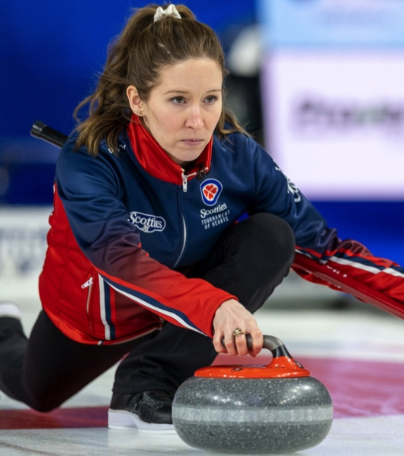
Flat-Foot Delivery
The defining characteristic of a Flat-Foot delivery is that the slider heel remains in contact with the ice at all times.
National Training and Development Centre

Slide 19
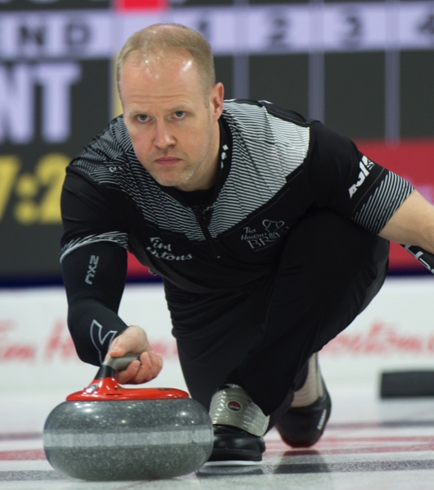
Raised-Heel Delivery
The defining feature of a Raised Heel delivery is that the slider heel sits just above the ice surface during the slide.
National Training and Development Centre

Slide 20
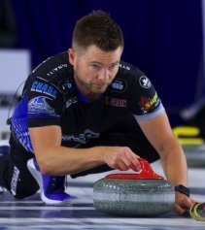
Toe-Tuck Delivery
The defining characteristic of a Toe-Tuck Delivery is that the slider heel sits against the thigh of the trailing leg during the slide.
National Training and Development Centre

Slide 21
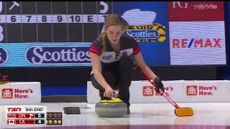
Flat-Foot Delivery – Playlist 1
Kaitlyn Lawes has an excellent Flat-Foot delivery. She absolutely nails her line across the entire sheet.
To Watch Videos: Right Click on Image then Open Hyperlink.
National Training and Development Centre

Slide 22
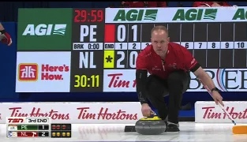
Raised-Heel Delivery – Playlist 2
Mark Nichols has an excellent Raised-Heel delivery. His mechanics give him seemingly effortless power.
To Watch Videos: Right Click on Image then Open Hyperlink.
National Training and Development Centre

Slide 23
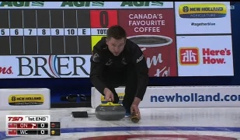
Toe-Tuck Delivery – Playlist 3
Mike McEwen has an excellent Toe-Tuck delivery. His release skills are arguably the best of any tucker.
To Watch Videos: Right Click on Image then Open Hyperlink.
National Training and Development Centre

Slide 24
Delivery Technique National Training and Development Centre

Slide 25
Delivery Phases
Setup
Drive
Slide
Release
National Training and Development Centre

Slide 26
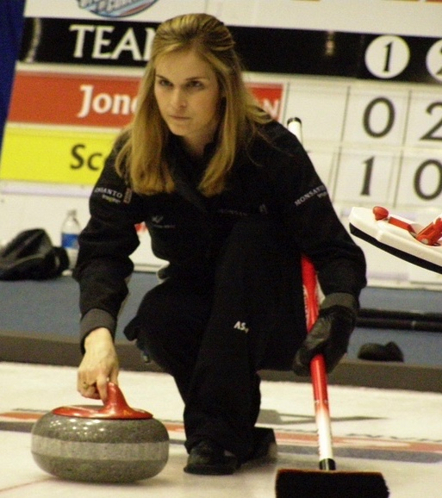
Phase 1 – Setup
The Setup is the only static phase of the delivery. It begins when the curler has taken aim, and ends when the body is set into motion.
National Training and Development Centre

Slide 27
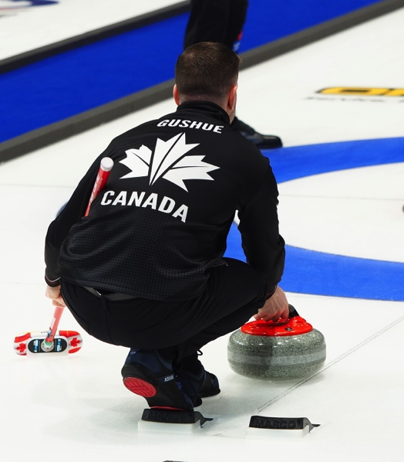
Setup – A Solid Foundation
The Setup serves as the foundation of the delivery. Any imprecision here will necessitate compensations later on.
National Training and Development Centre

Slide 28
Setup: Lower Body Checklist
Key Considerations | Technical Rationale
Ensure that the ball of the gripper foot is positioned squarely against the hack, with the laces pointing at the target broom. | This will promote a solid and consistent push off during the Drive phase, which enhances both line accuracy and weight control.
Position the heel of the slider foot even with the toe of the gripper foot, with both feet parallel to each other and 2-3 inches of lateral separation between them. | This squares the hips to the target line/path, and provides sufficient clearance for the slider foot to move straight back and through during the Drive.
Ensure that the body’s weight evenly distributed (i.e., 50% and 50%) between the slider foot and the gripper foot. | This not only encourages balance and stability in the Setup, but promotes these same conditions during the Drive phase as well.
Ensure that the knees stack on top of the feet, and that the hips are square (i.e., perpendicular) to the target line, as the body lowers into the hack. | This positioning will help the lower body to maintain its proper orientation to the target line throughout the rest of the delivery.
National Training and Development Centre

Slide 29
Setup: Upper Body Checklist
Key Considerations | Technical Rationale
Ensure that the shoulders are square (i.e., perpendicular) to the target line, and level (i.e., parallel) with the ice surface. | This makes it more likely for the upper body to maintain the proper orientation throughout the rest of the delivery.
Ensure that the throwing shoulder is internally rotated (i.e., palm in) on in-turns, and externally rotated (i.e., palm out) on out-turns. | This positioning will allow the throwing arm to soften properly during the Slide phase, and to extend properly during the Release phase.
Keep the throwing arm/elbow extended, while keeping the upper arm, forearm, and wrist all on the same plane. | This creates a strong lever that will carry forward into the Drive, where it will help to promote both line accuracy and weight control.
Ensure that the broom handle is either securely anchored across the back (at 30-35° to the target line), or that it is parallel to it and flat on the ice. | This helps to ensure that the broom will be in a suitable position to enhance stability throughout the rest of the delivery.
National Training and Development Centre

Slide 30
Setup: Rock & Handle Checklist
Key Considerations | Technical Rationale
Centre the rock at a chosen position between the middle and the centre-line edge of the hack, while also keeping it well ahead of the gripper kneecap. | This allows for side-to-side and front-to-back reference points in relation to the gripper kneecap, which can facilitate consistent rock positioning.
Ensure that the handle is already in its pre-set position (i.e., at 10 or 2 o’clock) before applying the grip to the handle. | This sets the stage for 4.5 to 5.0+ rotations when combined with a proper Release tempo, while also facilitating proper shoulder positioning.
Centre the index finger on the handle and establish the grip in a manner that puts a slight ‘break’ in the throwing wrist (i.e., a semi-high position). | This grip structure not only facilitates proper turn application, but encourages a ‘mini-set’ Release motion as well.
Establish a grip pressure between 4 and 6 on a scale of 1 to 10, with a potential variance within this range depending on the weight of the shot. | This recognizes that more sensitivity could be useful on draws (i.e., less pressure) and more control could be useful on heavy hits (i.e., more pressure).
National Training and Development Centre

Slide 31
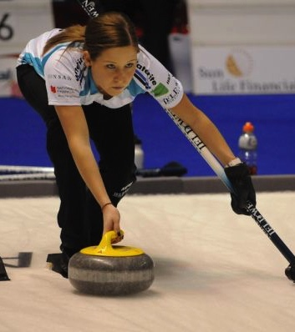
Phase 2 – Drive
The Drive is the first moving phase of the delivery. It begins when the body is set into motion, and ends when the curler leaves the hack.
National Training and Development Centre

Slide 32
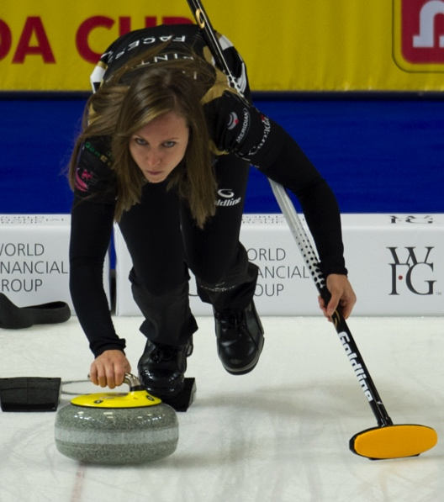
Drive – Staying Connected
The key to a successful Drive is to stay connected. This means that the body and rock work together as a cohesive unit.
National Training and Development Centre

Slide 33
Drive: Lower Body Checklist
Key Considerations | Technical Rationale
Ensure that the slider foot moves straight back and straight through, travelling on a direct line towards the target broom. | The path of the slider foot is a key consideration in line accuracy, and increases the likelihood of a proper ‘plant’ at the outset of the Slide phase.
Ensure that backward motion is powered by the hips, with an appropriate amount of body weight shifting onto the slider foot as it moves back. | This recognizes that more potential power is stored when more of the body’s weight has moved behind the hacks and onto the slider foot.
Initiate the forward motion by shifting body weight back onto the gripper foot, before shifting it forward onto the slider foot as it moves past the hack. | This is very similar to a walking or running motion, where weight is shifted to the lead foot in the chain in order to propel the body forward.
Push off from the hack with the necessary leg drive for the shot, while delaying the timing of this motion progressively as the weight of the shot increases. | This second point recognizes that a later push off is also a more horizontal one, with more force therefore transferred into the rock’s forward motion.
National Training and Development Centre

Slide 34
Drive: Upper Body Checklist
Key Considerations | Technical Rationale
Ensure that the shoulders and arms form a strong ‘frame’ to support the rock’s backward and forward motions during the Drive. | This helps to keep the rock on the extended target line as it moves backward, and on the actual target line as it moves forward.
Keep the shoulders square to the target line and level with the ice throughout the Drive, just as they were during the Setup. | This keeps the upper body properly oriented to the target line throughout the Drive, which is a key contributor to line accuracy.
Keep the throwing arm straight and diagonal to the ice (i.e., at least a 45° arm angle) during both the backward and forward motions. | This ensures that the throwing arm is positioned to be an effective lever, which enhances both line accuracy and weight control.
Keep the broom arm strong and stable throughout the Drive, while maintaining the exact same broom positioning as in the Setup. | This locks in the ‘broom-side’ of the frame, which can be an easy thing to overlook due to the natural focus on the ‘rock-side’ of the frame.
National Training and Development Centre

Slide 35
Drive: Rock & Handle Checklist
Key Considerations | Technical Rationale
If an initial ‘forward press’ is used, ensure that the rock only moves forward a short distance (i.e., no more than 2-3 inches). | This is because a longer motion is bound to activate the small muscles of the forearm, which are best to remain passive during the Drive.
Allow the rock to move straight backward and forward along the target line, without any active contribution from the throwing arm. | This recognizes that the Drive should be controlled by the big muscles of the lower body, with a strong upper body frame also stabilizing the rock’s path.
Ensure that the rock is always the furthest point forward during both the backward and forward motions of the Drive. | This will be the case as long as the strong upper body frame is maintained, since this includes a distinct forward arm angle.
Maintain the same handle positions (i.e., 10 or 2 o-clock), grip structure, and grip pressure (i.e., 4 to 6 out of 10) as established during the Setup. | This sets the stage for 4.5 to 5.0+ rotations, while striking an appropriate balance between sensitivity and control.
National Training and Development Centre

Slide 36
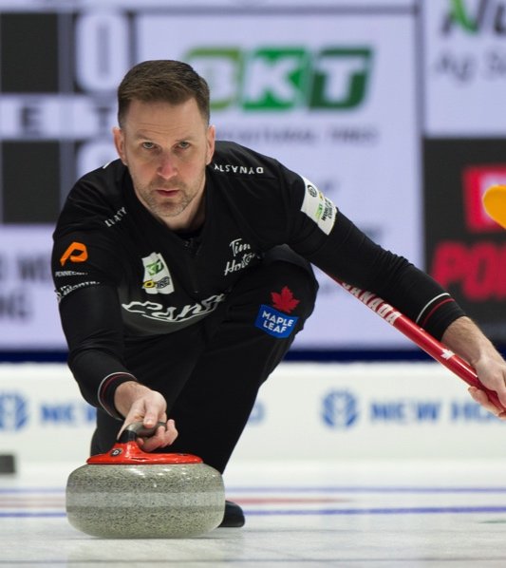
Phase 3 – Slide
The Slide begins when the curler leaves the hack, and ends (from a technical perspective) when the Release motion is initiated.
National Training and Development Centre

Slide 37
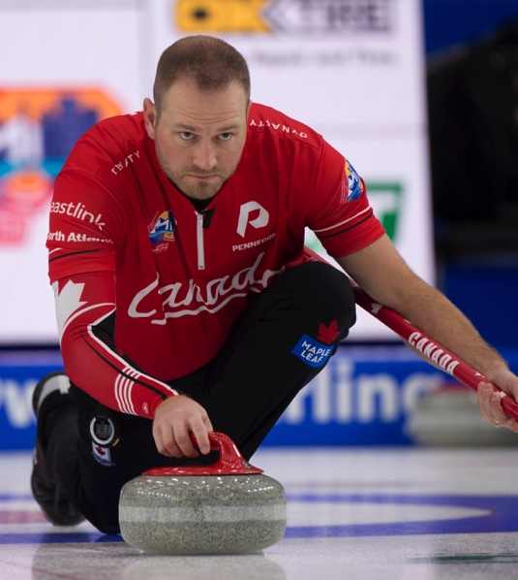
Slide – Balance is Everything
The key to any successful Slide is good balance. That is, the dynamic stability of rock and body as they move towards the target.
National Training and Development Centre

Slide 38
Slide: Lower Body Checklist
Key Considerations | Technical Rationale
Ensure that the slider foot ‘plants’ accurately on the target line, with the inside edge of the ankle aligned with the mid-line of the rock. | This eliminates both a ‘drift’ (i.e., planting too far across the rock’s mid-line) and a ‘fade’ (i.e., planting well short of the rock’s mid-line).
Ensure that the front-to-back positioning of the slider foot is appropriate to the slide style (i.e., further forward for flat-foot, further back for toe-tuck). | This promotes superior balance and stability throughout the Slide, which enhances both line accuracy and weight control.
Ensure that the hips are still square, and that the trailing leg is now fully extended and entirely within the the outer borders of the rock. | This is important because a line drawn from the trailing foot to the throwing hand is actually what the curler perceives as the correct Slide line.
Orient the gripper foot so it sits as square to the ankle as possible, ideally with the tops of the toes in contact with the ice. | Unlike the other options (i.e., toed-in, toed-out, or just the tips of the toes), this positioning both enhances stability and reduces friction.
National Training and Development Centre

Slide 39
Slide: Upper Body Checklist
Key Considerations | Technical Rationale
Keep the shoulders square to the target line and level with the ice, while maintaining the same broom position as during the Setup and Drive. | This helps to maintain the proper orientation of the upper body throughout the Slide, which is a key contributor to line accuracy.
Keep the head centred on the target line, knowing that it can still be cocked so that either eye aligns with the mid-line of the rock. | This recognizes that one eye is typically dominant from a sighting standpoint, and that the head can be oriented to address this reality.
Keep the throwing arm/elbow extended for the early part of the Slide (i.e., approximately between the back-line and the t-line). | This is a continuation of the arm’s positioning in the Drive, and is appropriate since the shoulders will still be a little higher at this point.
Allow the throwing arm to soften at the elbow as the Slide continues (i.e., approximately between the t-line the top of the rings). | This offers greater sensitivity to the speed of the rock, while setting the stage for some related fine-tuning during the Release phase.
National Training and Development Centre

Slide 40
Slide: Rock & Handle Checklist
Key Considerations | Technical Rationale
Keep the rock moving straight forward along the target line, understanding that the body will now be directly behind it. | This puts the body in a position to sight the target line properly, and to monitor the rock’s speed as the delivery moves towards Release.
Maintain the same handle positions (i.e., 10 or 2 o-clock), grip structure, and grip pressure (i.e., 4 to 6 out of 10) as during the Setup and Drive. | This sets the stage for 4.5 to 5.0+ rotations, while striking an appropriate balance between sensitivity and control.
When delivering an in-turn, the throwing elbow should point as much out as downward once the arm has softened. | This is a natural result of the internal shoulder rotation established in the Setup, and helps to facilitate a mini-set Release.
When delivering an out-turn, the throwing elbow should point straight down to the ice once the arm has softened. | This is a natural result of the external shoulder rotation established in the Setup, and helps to facilitate a mini-set Release.
National Training and Development Centre

Slide 41
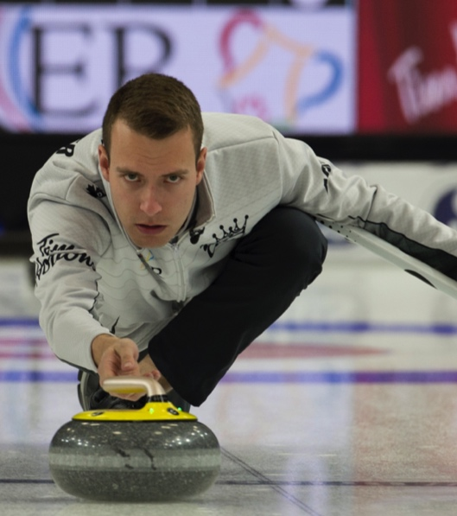
Phase 4 – Release
The Release begins with arm extension and turn application, and ends when the curler completes their follow-through.
National Training and Development Centre

Slide 42
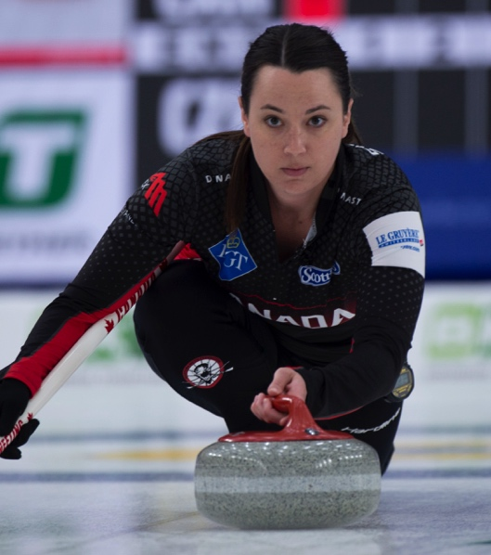
Release – The Moment of Truth
The Release is the moment of truth in any delivery. A poor Release can cancel out all the good work that’s taken place previously.
National Training and Development Centre

Slide 43
Release: Lower Body Checklist
Key Considerations | Technical Rationale
Keep slider foot directly below the vertical mid-line of the body, with the inside of that ankle bisecting the rock, just as it was during the Slide | This promotes balance and stability, and helps to ensure that both rock and body remain within the target path (i.e., lane).
Maintain the exact same slider foot positioning (i.e., flat-foot, raised-heel, or toe-tuck) that existed during the Slide. | This ensures that there is no change to the the body’s main balance point (i.e., the slider foot) at this late juncture of the delivery.
Ensure that the hips are still square, and that the trailing leg is still extended and entirely within the the outer borders of the rock. | This is important because a line drawn from the trailing foot to the throwing hand is actually what the curler perceives as a ‘pure’ Release line.
Maintain the exact same gripper foot positioning that existed during the Slide (i.e., ideally square to the ankle, with the top of the toes on the ice). | This recognizes that a late change to the orientation of the gripper foot could have a negative impact on the body’s direction.
National Training and Development Centre

Slide 44
Release: Upper Body Checklist
Key Considerations | Technical Rationale
Ensure that the shoulders remain square to the target line and level with the ice throughout the entire Release phase. | This orientation positions the shoulders on either side of the target line, which can be a valuable reference point in relation to Release direction.
Extend the throwing arm smoothly over a distance of at least 6 feet, understanding that this distance should lengthen with increased weight. | This deliberate motion helps to ensure that the extension of the throwing arm is never too abrupt, with no ‘jabbing’ involved.
Begin the turn application about halfway through the arm extension, while using a purposeful and consistent tempo (i.e., cadence) with both turns. | This sequencing and tempo are both key contributors to producing the desired rotation (i.e., 4.5 to 5.0+ turns to an unimpeded stop).
Maintain the same throwing arm position that existed at separation until the end of the follow-through (i.e., at least 6 feet). | This provides important feedback to the curler’s nervous system with respect to how the rock has just been released.
National Training and Development Centre

Slide 45
Release: Rock & Handle Checklist
Key Considerations | Technical Rationale
Direct the rock from the middle towards the outside of the target broom head while the throwing arm extends and turn is applied. | This ‘mini-set’ motion has proven to work well on all shots and under all playing conditions (i.e., from curling clubs to arenas).
Rotate the handle from its pre-set position (i.e., 10 or 2 o’clock) to a point just before 12 o’clock, where it will separate from the hand. | This reduces the likelihood of drastically redirecting the rock’s direction at Release, either by turning it in or setting it out too much.
On an in-turn, 1-2 knuckles (and therefore none of the palm) should be visible between separation and the end of the follow-through. | This in-turn hand positioning is entirely consistent with the separation of hand from handle occurring just before 12 o’clock.
On an out-turn, 1-2 palm pads (and therefore no knuckles) should be visible between separation and the end of the follow-through. | This out-turn hand position is entirely consistent with the separation of hand from handle occurring just before 12 o’clock.
National Training and Development Centre

Slide 46
Delivery Analysis National Training and Development Centre

Slide 47
Analysis Principle 1 – External Consistency
While we definitely want all our curlers to develop superior technique, no two curlers will deliver in exactly the same way.
Therefore, we need to accept a certain range of technique, provided that it produces the intended line, weight, and rotation.
National Training and Development Centre

Slide 48
Analysis Principle 2 – Internal Consistency
Beyond what exists from curler to curler, we must also accept a certain amount of technical variability within each curler.
Everyone’s going to slide a little wide or narrow, light or heavy at times, but that doesn’t necessarily equate to a technical flaw.
National Training and Development Centre

Slide 49
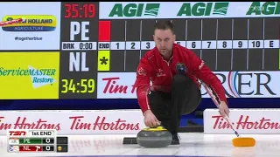
Flat-Foot Delivery – Playlist 4
Brad Gushue has a really sound Flat-Foot delivery. There’s nobody better when it comes to planting his slider foot.
To Watch Videos: Right Click on Image then Open Hyperlink.
National Training and Development Centre

Slide 50
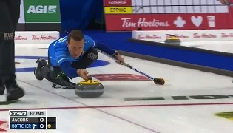
Flat-Foot Delivery – Playlist 5
Brendan Bottcher also has a very effective Flat-Foot delivery. But, what do you notice that differs from what we’ve discussed?
To Watch Videos: Right Click on Image then Open Hyperlink.
National Training and Development Centre

Slide 51
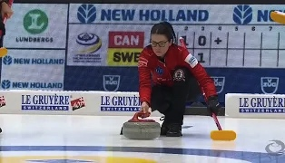
Raised-Heel Delivery – Playlist 6
Keri Einarson has a really sound Raised-Heel delivery. She’s meticulous about both aim and alignment in her Setup.
To Watch Videos: Right Click on Image then Open Hyperlink.
National Training and Development Centre

Slide 52
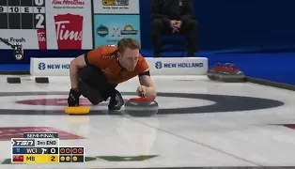
Raised-Heel Delivery – Playlist 7
Marc Kennedy also has a very effective Raised-Heel delivery. But, what do you notice that differs from what we’ve discussed?
To Watch Videos: Right Click on Image then Open Hyperlink.
National Training and Development Centre

Slide 53
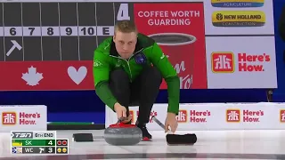
Toe-Tuck Delivery – Playlist 8
Colton Flasch has a really sound Toe-Tuck delivery. He does a great job of getting his body onto the target line.
To Watch Videos: Right Click on Image then Open Hyperlink.
National Training and Development Centre

Slide 54
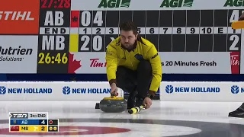
Toe-Tuck Delivery – Playlist 9
Matt Dunstone also has a very effective Toe-Tuck delivery. But, what do you notice that differs from what we’ve discussed?
To Watch Videos: Right Click on Image then Open Hyperlink.
National Training and Development Centre

Slide 55
Common Faults & Fixes
In the remaining slides we’ll look at some common delivery faults, along with some fixes that have helped many curlers throw the intended line, weight, and/or rotation more consistently.
National Training and Development Centre

Slide 56
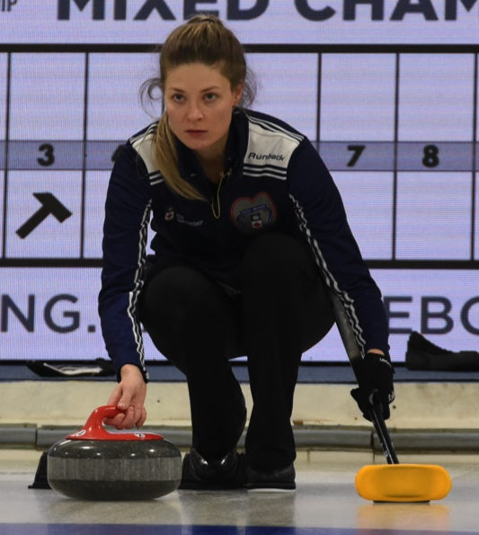
Setup Fault – Imprecise Alignment
One of the most common faults that we see in the Setup is the imprecise alignment of of rock and body in relation to the target line.
National Training and Development Centre

Slide 57
Setup Fix – Precise Alignment
Jennifer Jones takes great care to aim her body precisely at the target broom, and then to align the rock precisely with her body.
National Training and Development Centre

Slide 58
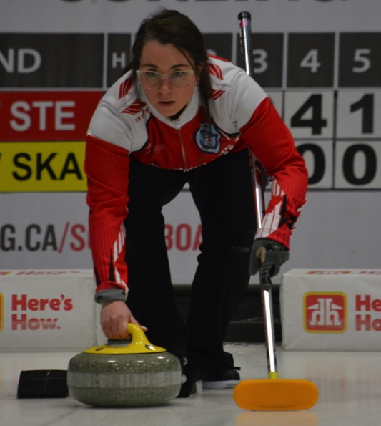
Drive Fault – Open Hips
One of the most common faults that we see in the Drive is the opening the of the slider foot, knee, and hip to the target line.
National Training and Development Centre

Slide 59
Drive Fix – Square Hips
Kaitlyn Lawes keeps her hips square throughout the Drive by ensuring that her slider foot remains straight on her ankle.
National Training and Development Centre

Slide 60
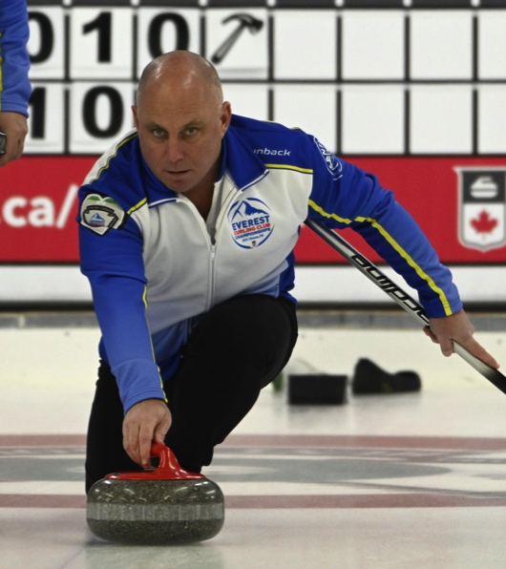
Slide Fault – Open Shoulders
One of the most common faults that we see in the Slide is the progressive opening of the broom arm and shoulder to the target line.
National Training and Development Centre

Slide 61
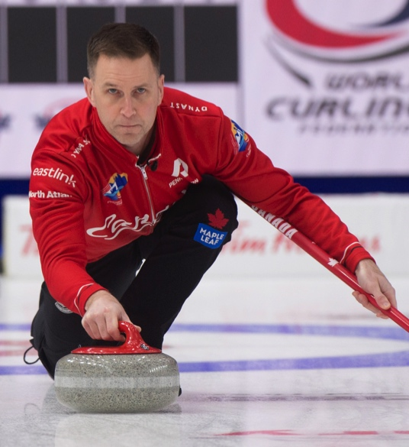
Slide Fix – Square Shoulders
Brad Gushue keeps his shoulders square throughout his delivery by locking his broom into position during the Setup.
National Training and Development Centre

Slide 62
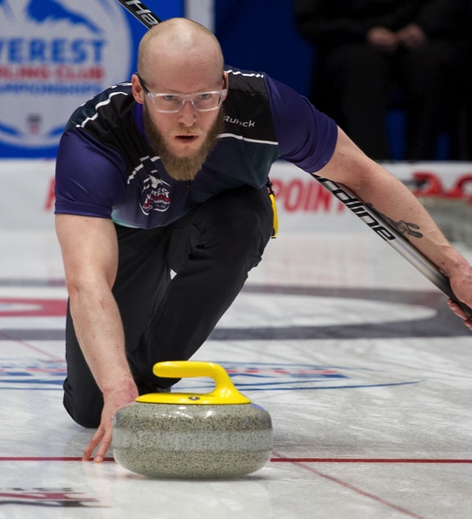
Release Fault – No Follow-Through
One of the most common faults that we see at Release is letting the throwing hand drop to the ice immediately after separation.
National Training and Development Centre

Slide 63
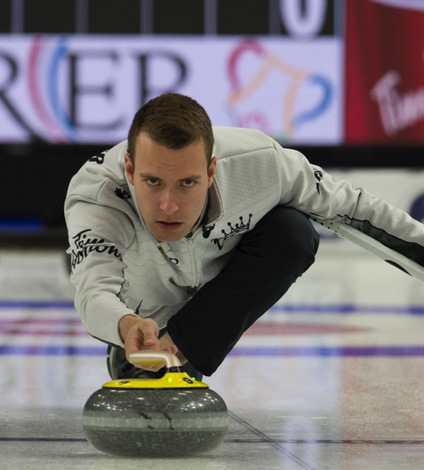
Release Fix – Proper Follow-Through
Brendan Bottcher gains valuable feedback from every shot by keeping his throwing hand in position well into his follow-through.
National Training and Development Centre

